Slide 1
ServiceNow An Introduction
Revature ServiceNow Team – Prakash Agrawal, Shreysh Mane, Ethan Wilson

Slide 2
Agenda
01
02
03
04
What is ServiceNow
Why it’s awesome
Job Opportunities
Questions

Slide 3
What is ServiceNow
01
ServiceNow provides many services, too many to list here. The ServiceNow platform is most known, however, for their ITSM, ITOM, and CSM service offerings.

Slide 4
What the heck is ITSM, ITOM, and CSM?
ITSM – IT Service Management (ITSM) manages IT infrastructure and services, including incident management, problem management, change management, and asset management.
ITOM – IT Operations Management (ITOM) supports the performance and availability of IT infrastructure and sevices, including networks, servers, and applications.
CSM – Customer Service Management (CSM) is used to deliver a personalized customer service experience across all communication mediums, i.e. email, phone calls, ect.

Slide 5
ITIL
The Information Technology Infrastructure Library (ITIL) is a framework of best practices for delivering ITSM.
Many companies already use ITIL within ServiceNow to work with:
Change Management
Problem Management
Incident Management

Slide 6
ServiceNow Platform
SaaS and aPaaS.

Slide 7
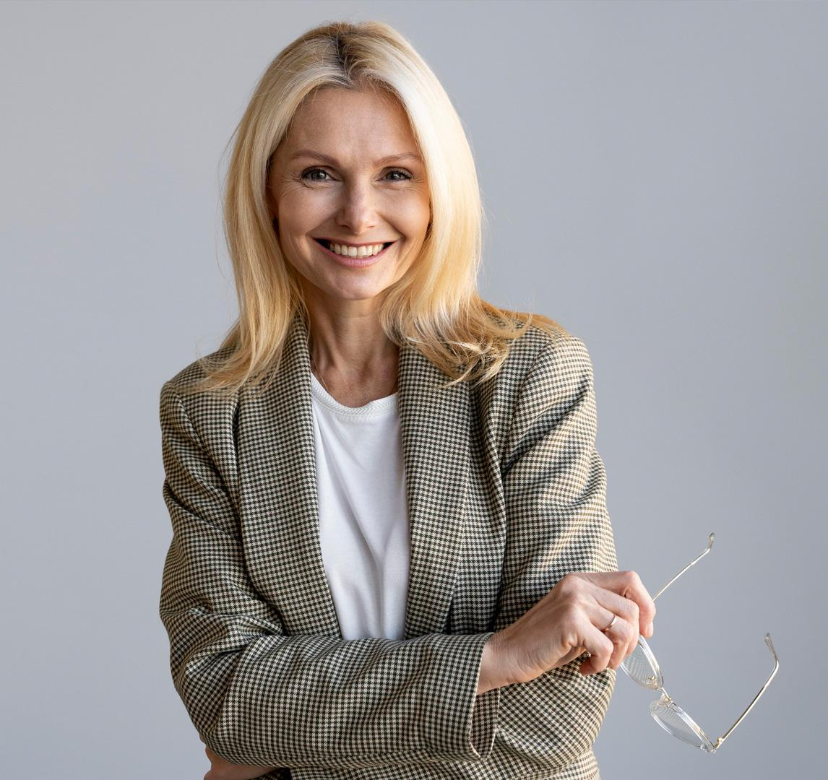


Why is ServiceNow awesome?
Susan Bones
Timmy Jimmy
Jenna Doe
You can speak a bit about this person here
You can speak a bit about this person here
You can speak a bit about this person here

Slide 8
Problem
Earth is the third planet from the Sun and the only one that harbors life in the Solar System. This is where we all live

Slide 9
Them vs. us
Augmented reality
Virtual reality
Mercury is the closest planet to the Sun and the smallest one of them all—it’s only a bit larger than the Moon
Venus has a beautiful name and is the second planet from the Sun. It’s hot and has a poisonous atmosphere

Slide 10
Solution
Despite being red, Mars is actually a cold place. It's full of iron oxide dust, which gives the planet its reddish cast

Slide 11
Awesome words

Slide 12
02
Why is ServiceNow Awesome?

Slide 13
We have options
Customize the UI from point and click tools, scripts, and more.
Get detailed reports and dashboards to see current and projected trends.
Integrate 3rd party apps and databases.
Get detailed info on instance performance.
Leverage process automation tools such as Flows to increase efficiency.
Easily manage updates, security, and database tables with easy-to-use point and click tools.

Slide 14
We have options
Strengths
Weaknesses
Jupiter is the biggest planet of them all
Venus is the second planet from the Sun
Opportunities
Threats
Despite being red, Mars is actually a cold place
The Sun is the star at the center of the Solar System

Slide 15
Our plans
Basic
Jupiter is the biggest planet of them all
Characteristic Characteristic Characteristic
$70
Standard
The Sun is the star at the center of the Solar System
Characteristic Characteristic Characteristic
$120
Premium
Despite being red, Mars is actually a cold place
Characteristic Characteristic Characteristic
$150

Slide 16

Product demo
You can replace the image on the screen with your own work. Just right-click on it and select “Replace image”
Insert your multimedia content here

Slide 17
Job Opportunities
85% of fortune 500 companies utilize ServiceNow.
$114b in market capitalization.
Consistent growth last 10 years.
Thousands of job postings.
03
Source: https://seekingalpha.com/article/4630349-servicenow-a-business-powerhouse

Slide 18
489,236
Big numbers catch your audience’s attention

Slide 19
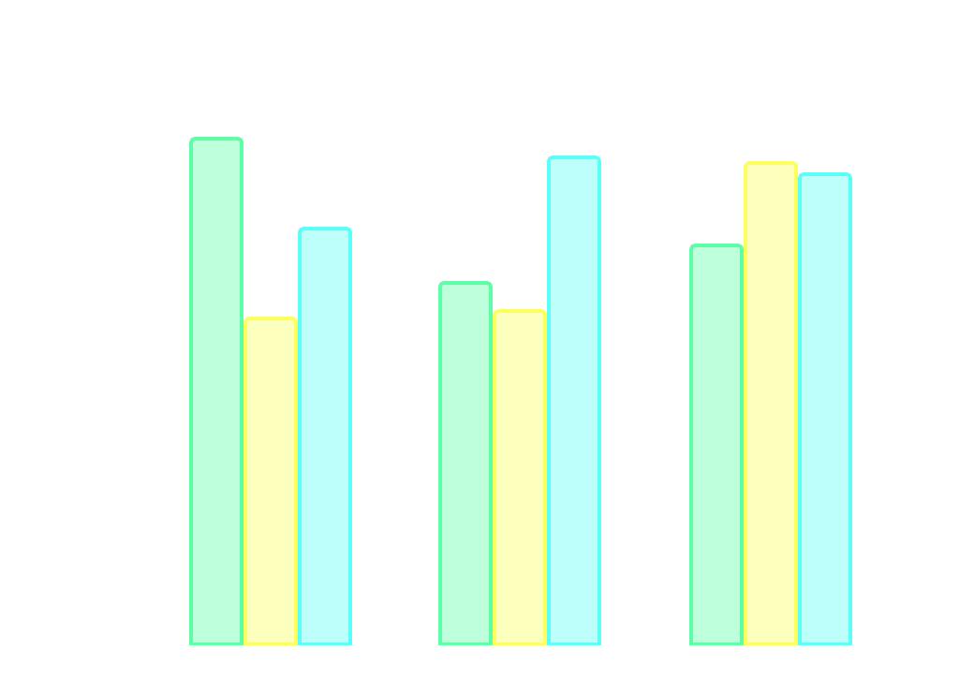
This is a graph
Venus
Mars
Ceres
$1,850
Average user savings per deal
$516,500
Annual revenue
28,362
Total app downloads
2019
2020
2021
Follow the link in the graph to modify its data and then paste the new one here. For more info, click here

Slide 20
Case study
Mercury's name has nothing to do with the liquid metal, since Mercury was named after the Roman messenger god
Challenge
Earth is the third planet from the Sun and has life
Results
Solution
Neptune is the farthest planet from the Sun
Jupiter is the biggest planet in the Solar System

Slide 21
Resources
ServiceNow Developer Docs
ServiceNow Product Docs
ServiceNow Community
ServiceNow Knowledge Base Articles
ServiceNow Basics Module - Set Up a Personal Developer Instance

Slide 22
Questions?
04

Slide 23
Awards
Mars
Mercury
Venus
04
Despite being red, Mars is actually a cold place. It’s full of iron oxide dust
It’s the closest planet to the Sun and the smallest one in the Solar System
Venus has a beautiful name and is the second planet from the Sun

Slide 24

A picture is worth a thousand words

Slide 25
Market size
36%
64%
Jupiter
Venus
Jupiter is a gas giant and the biggest planet in the Solar System
Venus has a beautiful name and is the second planet from the Sun

Slide 26
Target
21-32
70%
33-45
61%
46-56
39%
Gender
Age range
57%
43%
Hobbies
Mars is actually a cold place
Earth is where we all live
Saturn has several rings

Slide 27
$369,178
+25%
2023
Ceres is located in the main asteroid belt
Mercury is the smallest planet
Neptune is far away from Earth

Slide 28
Main competitors
Mercury
Venus
Jupiter
Neptune
It’s the closest planet to the Sun and the smallest one in the Solar System
Venus has a beautiful name and is the second planet from the Sun
Jupiter is a gas giant and the biggest planet in the Solar System
It's the fourth largest object by diameter in the Solar System

Slide 29
Business model
Marketing | Training | Assessment | Technology
Jupiter is a gas giant and the biggest planet in the Solar System | Neptune is the farthest planet from the Sun. It’s cold there | Despite being red, Mars is actually a very cold place to live | Earth is the only planet that harbors life in the Solar System
Saturn is a gas giant | Mercury is small | Pluto is small | Ceres is small

Slide 30
Project timing
Jupiter is the biggest planet of them all
The Moon is Earth’s only natural satellite
Phase 2
Phase 4
Phase 1
Phase 3
Mars is a cold place, full of iron oxide dust
Saturn is a gas giant and has several rings

Slide 31
—Someone Famous
“This is a quote, words full of wisdom that someone important said and can make the reader get inspired.”

Slide 32

Predicted growth
Mercury
It’s the closest planet to the Sun and the smallest one of them all
+$500,000
Expected income for 2022
21,500
New users next year
Follow the link in the graph to modify its data and then paste the new one here. For more info, click here

Slide 33

Investment
$7,750
$6,900
Saturn is a gas giant and has several rings
Ceres is in the main asteroid belt
$5,700
$8,500
Jupiter is the biggest planet of them all
The Moon is Earth’s only natural satellite
Follow the link in the graph to modify its data and then paste the new one here. For more info, click here

Slide 34
Thanks!
Do you have any questions?
youremail@freepik.com
+91 620 421 838
yourcompany.com
Please keep this slide for attribution

Slide 35
Virtual & augmented reality icon pack

Slide 36
Alternative resources

Slide 37
Alternative resources
Here’s an assortment of alternative resources whose style fits the one of this template:
Vectors
People using augmented reality on smartphones
People using augmented reality on smartphones I

Slide 38
Instructions for use
If you have a free account, in order to use this template, you must credit Slidesgo by keeping the Thanks slide. Please refer to the next slide to read the instructions for premium users.
As a Free user, you are allowed to:
- Modify this template.
- Use it for both personal and commercial projects.
You are not allowed to:
- Sublicense, sell or rent any of Slidesgo Content (or a modified version of Slidesgo Content).
- Distribute Slidesgo Content unless it has been expressly authorized by Slidesgo.
- Include Slidesgo Content in an online or offline database or file.
- Offer Slidesgo templates (or modified versions of Slidesgo templates) for download.
- Acquire the copyright of Slidesgo Content.
For more information about editing slides, please read our FAQs or visit Slidesgo School:
https://slidesgo.com/faqs and https://slidesgo.com/slidesgo-school

Slide 39
Instructions for use (premium users)
As a Premium user, you can use this template without attributing Slidesgo or keeping the "Thanks" slide.
You are allowed to:
Modify this template.
Use it for both personal and commercial purposes.
Hide or delete the “Thanks” slide and the mention to Slidesgo in the credits.
Share this template in an editable format with people who are not part of your team.
You are not allowed to:
Sublicense, sell or rent this Slidesgo Template (or a modified version of this Slidesgo Template).
Distribute this Slidesgo Template (or a modified version of this Slidesgo Template) or include it in a database or in any other product or service that offers downloadable images, icons or presentations that may be subject to distribution or resale.
Use any of the elements that are part of this Slidesgo Template in an isolated and separated way from this Template.
Register any of the elements that are part of this template as a trademark or logo, or register it as a work in an intellectual property registry or similar.
For more information about editing slides, please read our FAQs or visit Slidesgo School:
https://slidesgo.com/faqs and https://slidesgo.com/slidesgo-school

Slide 40
Fonts & colors used
This presentation has been made using the following fonts:
Montserrat
(https://fonts.google.com/specimen/Montserrat)
Barlow Semi Condensed
(https://fonts.google.com/specimen/Barlow+Semi+Condensed)
#1e1e1e
#ffffff
#2d2d2d
#f3f3f3
#b7b7b7
#955cff
#fdff5c
#5cfff8
#5cffa6
#ff5c5c

Slide 41

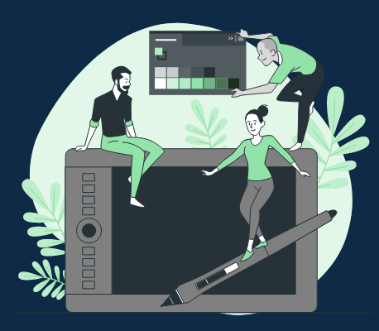



Storyset
Create your Story with our illustrated concepts. Choose the style you like the most, edit its colors, pick the background and layers you want to show and bring them to life with the animator panel! It will boost your presentation. Check out how it works.
Pana
Amico
Bro
Rafiki
Cuate

Slide 42
Use our editable graphic resources...
You can easily resize these resources without losing quality. To change the color, just ungroup the resource and click on the object you want to change. Then, click on the paint bucket and select the color you want. Group the resource again when you’re done. You can also look for more infographics on Slidesgo.

Slide 45
JANUARY
FEBRUARY
MARCH
APRIL
MAY
JUNE
PHASE 1
Task 1
Task 2
PHASE 2
Task 1
Task 2
JANUARY
FEBRUARY
MARCH
APRIL
PHASE 1
Task 1
Task 2

Slide 48
...and our sets of editable icons
You can resize these icons without losing quality.
You can change the stroke and fill color; just select the icon and click on the paint bucket/pen.
In Google Slides, you can also use Flaticon’s extension, allowing you to customize and add even more icons.

Slide 49
Educational Icons
Medical Icons

Slide 50
Business Icons
Teamwork Icons

Slide 51
Help & Support Icons
Avatar Icons

Slide 52
Creative Process Icons
Performing Arts Icons

Slide 53
Nature Icons

Slide 54
SEO & Marketing Icons

Slide 55


